Slide 1
November 17, 2014
College Affordability in Kentucky

Slide 2
Factors Associated with Success in Postsecondary Education
College Readiness
Accessibility of Educational Opportunities
Support Services
Affordability
Aptitude & Capacity to Persevere

Slide 4
Adult Students

Slide 5
Center on Wisconsin Strategy (COWS) Calculations from 2011 American Community Survey data.

Slide 6
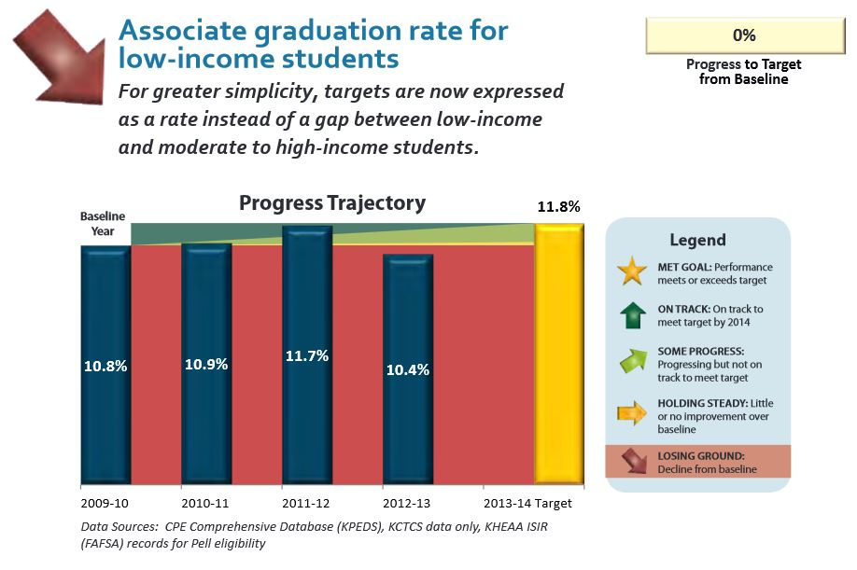
Source: Kentucky Council on Postsecondary Education Accountability Report 2012-2013.

Slide 7
Source: Source: Elizabethtown Community & Technical College; U.S Department of Education, Federal Student Aid.

Slide 8
Source: Kentucky Higher Education Assistance Authority.

Slide 9
Source: Kentucky Higher Education Assistance Authority. This analysis is based on KEES, CAP and KTG recipients for whom income information is available.

Slide 10
Source: Kentucky Higher Education Assistance Authority. This analysis is based on KEES, CAP and KTG recipients for whom income information is available.

Slide 11
Sources: Office of State Budget Director, 2014-2016 Budget of the Commonwealth.

Slide 12
Importance of Need-Based Aid for Low- and Moderate-Income Students
Effectively Influences Decision to Attend College
Increases Enrollment
Increases Persistence
Increases Number of Credits Earned

Slide 13
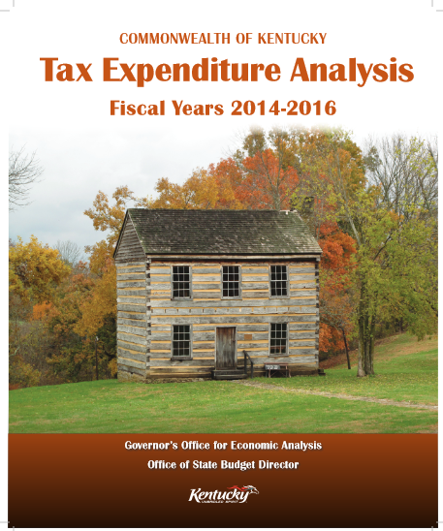
KY’s Postsecondary Education Tuition Tax Credit
Expected to cost the state $20.8 million in 2016—compared to $14.8 million in 2012
Benefits those with incomes well over $100,000
Kentuckians with incomes below federal poverty level do not qualify

Slide 14
Potential Directions
Eliminate Postsecondary Education Tuition Tax Credit and redirect funds to CAP
Make increased funding for postsecondary education institutions and need-based financial aid higher priorities
Allocate KENO lottery funds and any growth dollars in lottery funds to CAP
Consider moving forward CAP and KTG award date and/or taking extent of financial need into account when awarding
Study level of funding needed to incentivize low-income students to attend and persist in college

Slide 15
Some Ingredients for Low-Income Adult Student Success
Affordability
Supports
Career Pathways

Slide 16
Kentucky Center for Economic Policy
www.kypolicy.org
859-986-2373
aspalding@kypolicy.org

